Slide 1
What About The Higgs ?
Symmetry breaking and mass generation

Slide 2
Plan of this Presentation
Matter: Building blocks of the visible universe
Forces : Interactions and their mediators
Problem of mass : Why the Higgs?
Role of the Higgs in generating mass: Broken symmetry
Nature of the Higgs: fundamental or composite?
What other Physics may it be pointing to?

Slide 3
Matter
Quarks : SIX “flavors”
SIX Leptons
u up
d down
s strange
c charm
b bottom
t top
e electron
ν electron neutrino
μ muon
νμ muon neutrino
τ tau
ντ tau neutrino

Slide 4
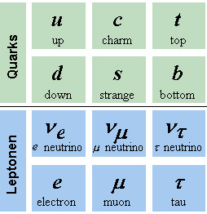
Iso spin doublets

Slide 5
Quantum numbers
Quarks
Electric charge ± 1/3, 2/3 e
“Weak iso-spin” ½ : +1/2 , -1/2
“Color”
Baryon number : ±1/3
Leptons
Electric charge ± 1 e
“Weak iso-spin” ½, 0
Lepton number ± 1 for the 3 types of leptons

Slide 6
FORCES
ALL force descriptions are based on the exchange of what should be “in principle massless” spin one particles called
“gauge” BOSONS.
Freedom of “gauge” is technically a freedom in the mathematical definition of these force particles
Relativity requires the use of four quantities for particles carrying spin 1 and we physically need only two hence a freedom in how one may define these independent two

Slide 7
Photons Couple to Electric Charge responsible for all electromagnetic interactions
Color gauge bosons
Couple to color charge
( come in 8 varieties )
Responsible for the “Strong force”: binding “colored quarks” to make “colorless” particles such as protons , neutrons etc …..
Weak Iso-spin gauge bosons
Couple to iso-spin charge
( come in 3 varieties)
Responsible for the “Weak force” coupling quarks to leptons through their “is-spin charge”
Leads to neutron decay etc…

Slide 8




All interactions are sequential Point Interactions
Photon emission by e
Photon emission by e⁺
Photon absorption by e
Photon absorption by e⁺

Slide 9
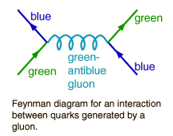
Similarly for color gauge and weak iso-spin ⁻interactions
Color Interaction
leads to a stronger force as the distance increases !
This ‘strong’ force is ‘confining’…..NO escape for Quarks or Gluons !
Weak Interactions
d
w+
u
ν e+
w+

Slide 10
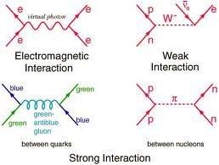
Three basic interactions and the residual nuclear Force

Slide 11
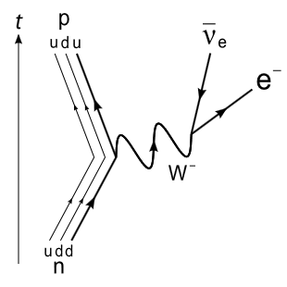

Weak Decay

Slide 12
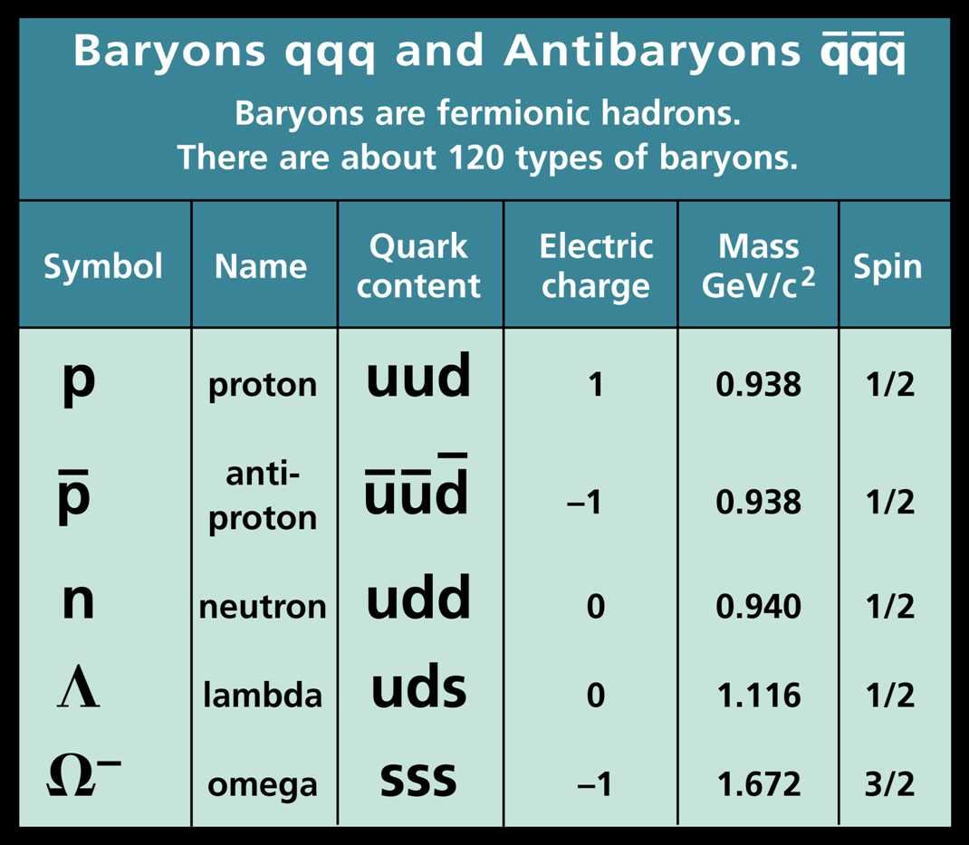
Hadrons (protons , Neutrons etc…) Structure

Slide 13
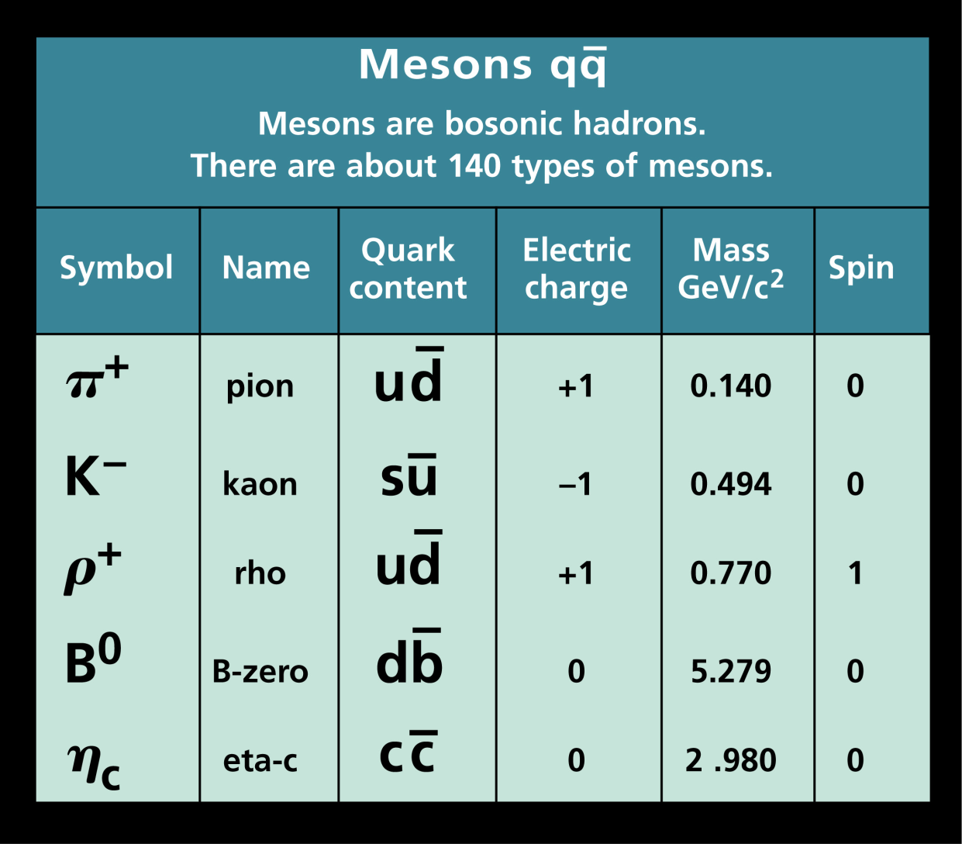
Mesons: π, K , ρ etc…

Slide 14
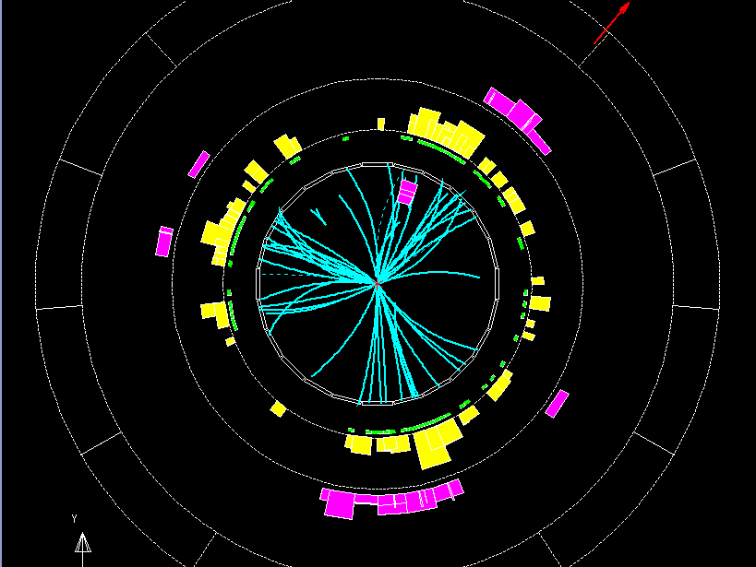
Three Jet event representing three quarks producing ‘colorless’ particles.

Slide 15
Imperfections
Neutrinos are all “left handed” ( the right handed ones are missing ? )
Reflection symmetry is not respected ( Parity violation) and the “weak interaction” distinguishes “right” from “left”
Iso-spin gauge ( W & Z ) fields must be “massive” to describe short range weak force
Introducing mass by hand Leads to a mathematically meaningless theory !!

Slide 16
Higgs Mechanism to the Rescue
Introduce four weak Iso-spin spin zero particles that self interact and also interact with:
quarks
leptons and
iso spin gauge fields

Slide 17

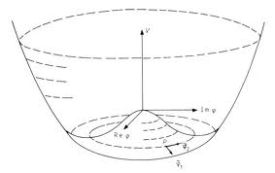
Assume an interaction of the form :
Self interaction is special as it has the form:

Slide 18
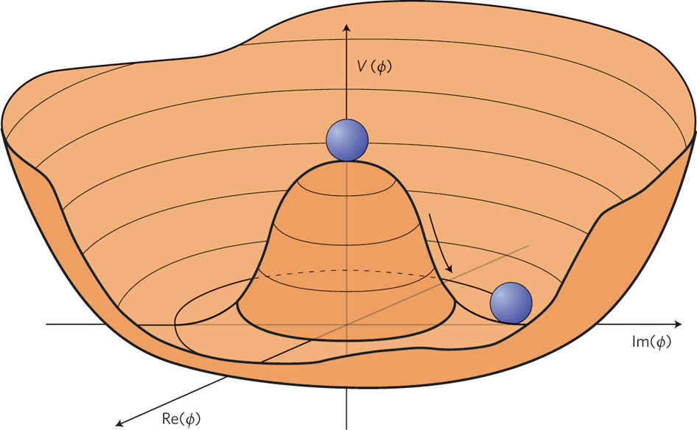
Leads to breaking of symmetry

Slide 19
Resulting in
Giving mass to the Iso-spin gauge bosons without destroying the mathematical structure through the second term in the expression of the interaction since
ϕ = ν + φ
and we have :
W W ν + W W φ
The first term representing a mass of value ν for the
W gauge boson ! The second term interactions with the Higgs particle.

Slide 20
Higgs Phase Transition
Transition into this symmetry breaking phase leads to a constant value for the Higgs field through out the universe
Massless matter coupling to this field, and traveling within a constant field background is slowed down and becomes massive
This includes ALL weak iso-spin carrying objects (quarks, leptons, W, Z )

Slide 21
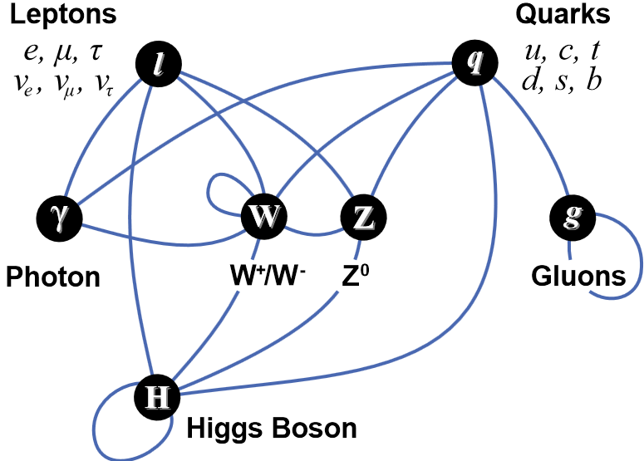
All Interactions + Higgs

Slide 22
Higgs Production
This is best done with the collision of particles carrying iso-spin charges such as quarks or leptons, hence:
proton - antiproton collisions may be used
(Fermilab Tevatron)
Electron positron collisions may be used
( Cern LEP collider )
Proton – proton collisions
(CERN LHC)
Future electron positron linear collider
(proposed at SLAC)

Slide 23
Higgs Detection
Gluon Emission of Higgs with Iso-spin partner.
Higgs decay into Iso-spin carrying products such as:
Quark pairs (effect seen through jets)
Lepton pairs
Iso-spin gauge particle pairs , WW, ZZ .
Or NEW modes to NEW matter

Slide 24
Higgs?
Is it a fundamental object of spin 0 ?
Is it a bound state of particles we have not seen yet?
Does it have partners of higher spin?
Is it a messenger from a world yet to be explored?

Slide 25
Possible surprises
Ratios of decays predicted by the standard model NOT satisfied
New decay modes to New Matter appear pointing to another sector of the universe that is unknown at this level of energy exploration.
New partners to the Higgs may appear showing the existence of long sought after “supper symmetry” multiplets

Slide 26
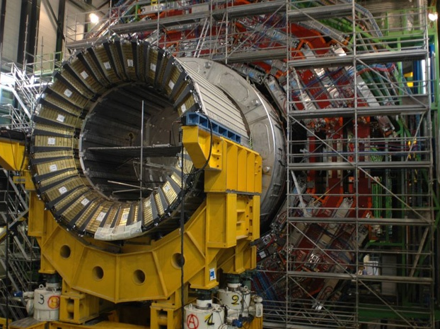
CMS detector at LHC (CERN)

Slide 27
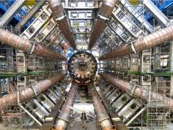
CMS Detector

Slide 28
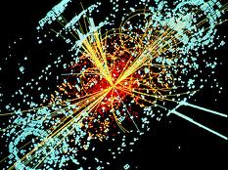
Visualization of a collision

Slide 29
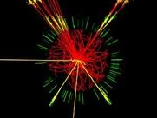
Quark jets after decay of the Higgs

Slide 30
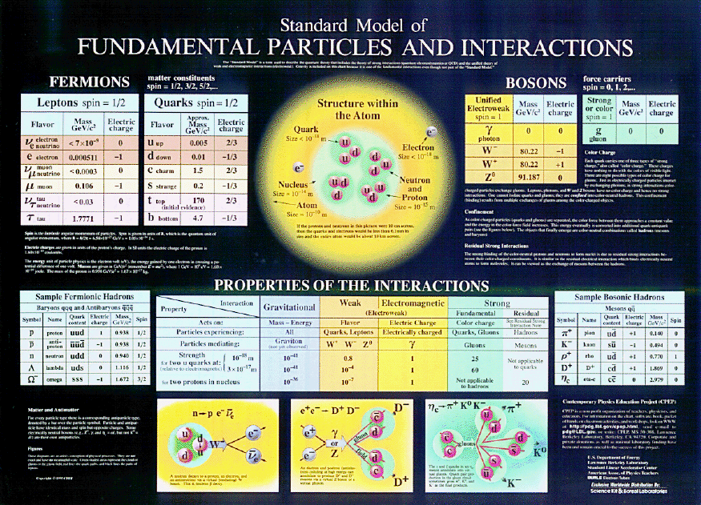
Standard Model summary

Slide 31
Inflationary universe
Higgs transition leads to fast expansion of the universe
expansion explains observed uniformity of the observed universe

