Slide 1
Space Time Lattice Approach to solving Quantum Field Theory
Non perturbative (Non Approximate) methods

Slide 2
Quantum Field Theory
Fields: These are “operator” mathematical objects defined over all space time that are formulated to describe elementary particle process such as creation and/or annihilation of particle states.
These fields are designed to have specific transformation properties under relativistic ( Lorentz) transformations.
Interactions among particles that they describe are written as products of such operators and such product must be invariant under such Lorentz transformations.
Further more these field operators must obey the rules of Quantum Mechanics as they describe processes at very short distances.

Slide 3
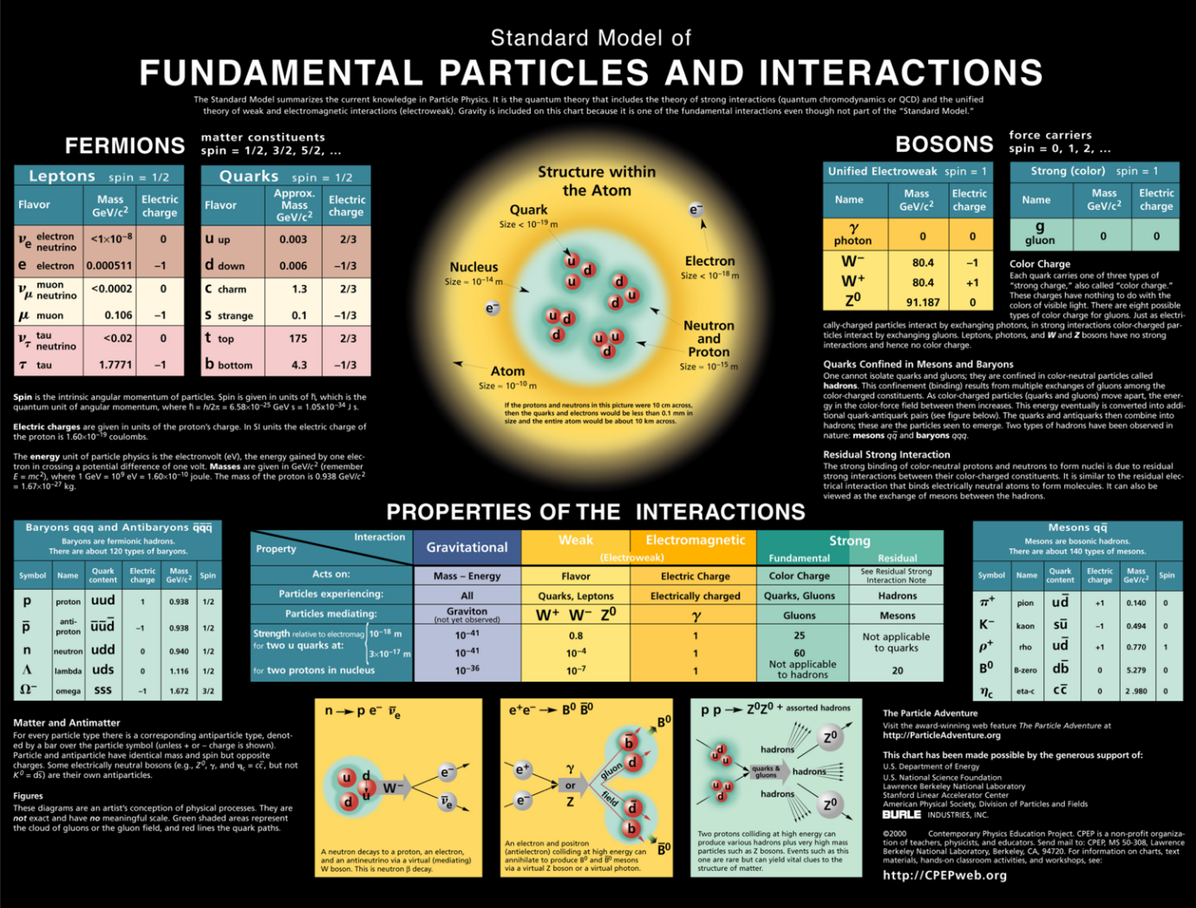
Elementary particles of the standard model

Slide 4
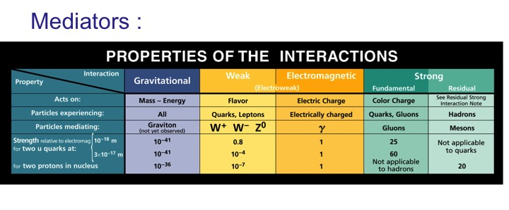
Forces

Slide 5
Types of fields
The types of fields used represent the characteristics of the basic particles one encounters in the standard model of fundamental particles:
1. spin zero fields ( possibly one Higgs)
2. Dirac Fields ( spin ½ particles) : matter particles
3. Four vector fields ( spin 1 particles) : force particles

Slide 6
Characteristics of Interactions
All interactions are point like !
Interactions involve multitude of processes
The net effect is obtained as a result of the collective effect of all such interactions.

Slide 7
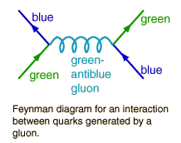
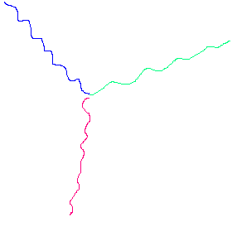
Example: Interactions among Colored quarks
Gluons
Interaction is point like and takes the following forms
This ‘strong’ force is ‘confining’…..NO escape for Quarks or Gluons !
leads to a stronger force as the distance increases !
leads to a stronger force as the distance increases !

Slide 8
Path Integral formulation of quantum mechanics
The Schrodinger equation defines an infinitesimal progress in time for the state function as driven by the energy of the system
( Hamiltonian). In general one has :
| A (x, T) > = e^{-iHT} | A(x, 0) >
< B (x, T) | A(x, T) > = < B(x, T) | e^{-iHT} | A (x,0) >

Slide 9
Slicing Time
Dividing T into many slices of time δt such that T = N δt We can make the following statement for the time evolution operator:
e^{-iHT} = ∏_{i=1}^{N} [exp ( -ip²/2m) δt] [exp-I V(x) δt] although [x,p]≠ 0
Further more we have from the completeness of position and momentum eigen states the identities:
∫dx | x >< x| = 1 and ∫ dp |p >< p| =1 which can also be inserted in between the two termc above in a succession of time slices.

Slide 10
Result is a multi dimensional integral !
The matrix elements of the operators are now simple numbers and one has, including the resultant state functions of the initial and final states <x| A(x,0)> = Ψ_{A} (x,0) & Ψ*_{B} (x_{N} ,T) = < B(x,T) | x_{N}> a 2N dimensional integral , N over x and N over p.
The exponential exp -i (p² δt/2m) finds itself sandwiched between a momentum and a position states: as such a sequence :
|x_{i-1} > < x_{i-1} | exp –i (p²/2m) δt |p_{i} > < p_{i} | exp-i(p²/2m) δt | x_{i} > < x_{i} |….
Then using < x_{i-1} | p_{i} > = exp(-ip_{i} x_{i-1} ) and
<p_{i} |x_{i} > = exp( ip_{i} x_{i} ) the terms combine to
…… exp –i(p_{i}² /2m) δt * exp ip_{i} (x_{i} –x_{i-1}) ……

Slide 11
Momentum integral is quadratic
Doing the momentum integral leads to an expression that combines the momentum and potential terms in the form of the Lagrangian that is integrated over time and the N integrals over all space slices.
Thus the matrix element takes finally the form:
∫∫∫….∫∫ ∏_{i=1}^{N} dx_{i} exp – iS
where S is the action
S = ∫₀^{T} dt L ( dx/dt, x).
This expression defines the path integral best done on a discrete space time lattice!
Note that the space integrals are TIME ORDERED …..

Slide 12
Interpretation
t=T
 |  | x₉ |  |  |  |  | x₉ |  | x₉
 |  |  | x₈ |  |  | x₈ |  | x₈
 |  | x₇ |  |  | x₆ |  | x₇
 |  |  | x₆ | x₆ |  | x₆
 |  | x₅ |  | x₅ | x₅
 |  |  | x₄ | x₄ | x₄
 |  |  | x₃ | X₃ | x₃
 |  |  | x₂ | x₂ | x₂
t=0 |  | x₁ | x₁ |  |  | x₁
X axis

Slide 13
Quantum mechanics as many paths !
One can then look at quantum mechanics as a sum over histories each history weighted by the negative exponential of the action associated with it !
Classical mechanics chooses the minimum action: most probable passage path !
Quantum mechanics takes that PLUS all near by paths of comparable action: Includes quantum fluctuations around the classical path !

Slide 14
Path Integral for Quantum Fields
Quantum fields represent many ( infinite) set of coordinates
Motion from slice of time to another represents a change of a whole field
The probability amplitudes are then sums over many field histories also weighted by the action for each such history
Results are then obtained by COMPUTING such sums !
Formidable infinite dimensional integrals involved over a four dimensional ( time and three space) space-time.
Methods?

Slide 15
Feynman graphs
At this stage if the interaction part of the action has a small “coupling strength” one can then write this part as a series in “powers of this small coupling” and generate a perturbation series or what are known as Feynman graphs that are graphic representation of this series.
e.g. for electromagnetic interactions this number is the fine structure constant of magnitude 1/137 !.
For many theories such a small number does not exist and further some terms cannot be expanded even for small values if the action has the inverse of such small values ( essential singularities)
In such cases one may consider the full action as a whole.

Slide 16
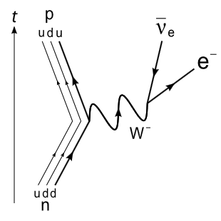
Examples

Slide 17
The path Integral
The sum over histories if done randomly, leads no where !
It is important however to recognize that these “histories” ( Field configurations) , when describing the correct theory, are distributed according to a “density” given by the “negative exponential of the action of the field theory”: the weight in the path integral.
A solution then can be achieved if such a distribution can be generated
With such a distribution all expectation values and transition probabilities in QM can then be computed NON-PERTUBATIVELY.
Monte Carlo methods are designed to generate any distribution from any initial configuration
As this is done numerically this requires a discretization of space-time
(four dimensions) over which these configurations may be defined and developed.

Slide 18
Monte Carlo Algorthim
A “configuration sample” approximating the density e^{-S(Φ)} for fields Φ(t, X) over the discretized space-time may be generated as a sequence { [Φ_{n} ] , 1≤ n ≤ N } in an updating algorithm Φ_{n} → Φ_{n+1}
Using a transition probability P [ Φ’ ← Φ ]
The transition probability should satisfy the following conditions:
P [ Φ’ ← Φ ] > 0 for all Φ
Σ_{Φ’} or ∫_{Φ’} P [ Φ’ ← Φ ] =1 (Ergodicity)
The intended distribution W_{c} is a fixed point for this transition probability : P [ Φ’ ← Φ ] W_{c} = W_{c} .

Slide 19
Detailed Balance
A sufficient condition for these conditions is detailed balance:
P [ Φ’ ← Φ ] W_{c} (Φ) = P [ Φ ← Φ’ ] W_{c} (Φ’)
This guarantees that Σ_{Φ’} on the left leads to W_{c} (Φ’) : the fixed point distribution.

Slide 20
Metropolis Algorithm
Define P for Φ’ ≠ Φ as follows:
| 1/N for W_{c} (Φ’) ≥ W_{c} (Φ)
P [ Φ’ ← Φ ] = |
| 1/N W_{c}(Φ’)/ W_{c}(Φ) if W_{c} (Φ’) < W_{c}(Φ)
Or equivalently:
P [ Φ’ ← Φ ] = 1/N Min { 1, W_{c}(Φ’)/ W_{c}(Φ) }

Slide 21
In our case:
Given a configuration Φ calculate the action S(Φ)
Select an alternate configuration Φ’ and compute the action S(Φ’) again.
If the new action is smaller then accept the new configuration Φ’ as [ W’_{c} ≥ W_{c}]
If the new action is larger then accept it with a probability of the ratio of the two distributions !
This last step is done by generating a random number distributed uniformly between zero (0) and one (1) and one takes the new configuration only if the ratio of the distributions is larger than the random number !
( more acceptances for near by actions less for far away ones!!)
Hence the name Monte Carlo !
This guarantees in the limit N largeof trials to generate a sample configuration with the correct distribution.

Slide 22
Sample results: Static quark potentials

Slide 23
Bound state masses

Slide 24
Zeros and phase behavior: Wilson action

Slide 25
Adjoint

Slide 26
SU2 critical exponent

Slide 27
Thank you
I hope you got an idea about the type of computations done …..

