Slide 1
Quantum Mechanics
A brief overview

Slide 2
Classical Mechanics
Newton’s Laws ( mass x acceleration =force)
m d² x/dt² = F = - gradient ( Potential energy)
Trajectories X(t) and momenta p(t) are determined together by initial conditions. For example Planetary orbits !
Maxwell’s Equations for Electricity and Magnetism
Electromagnetic waves propagate with the velocity of light.
Statistical Mechanics explains all Thermodynamics and its concepts.
(temperature, equations of state, entropy etc….)
Z = ∑ exp ( -E/kT)

Slide 3
Why Quantum Mechanics?
Discovery of the electron
Electrons travels in a magnetic field like any “particle” .
Discovery of the nucleus and radioactivity
Nuclei have positive charge ….and can emit particles !
Planetary Model for Atoms?
Failure of Classical Physics to account for atomic stability ..let alone structure …..

Slide 4
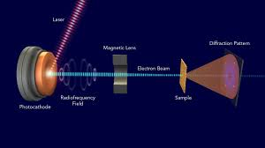
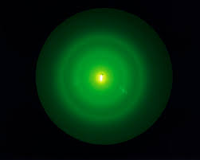

Wave nature of electrons
Diffraction

Slide 5
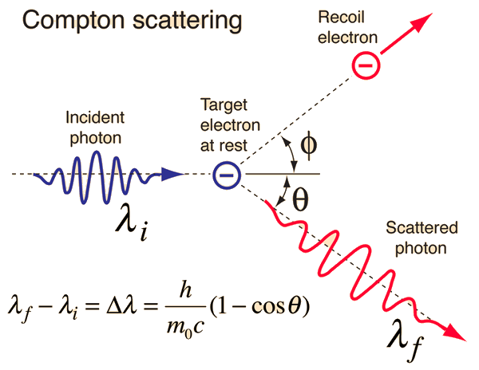
Particle nature of light
Compton Scattering

Slide 6
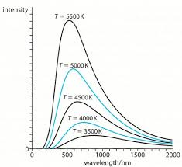
Black Body Radiation
Radiation distribution from a hot body:
E= h c/λ = h ν NOT in Maxwell’s EM theory

Slide 7

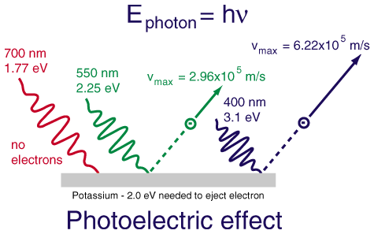
Photo Electric Effect

Slide 8
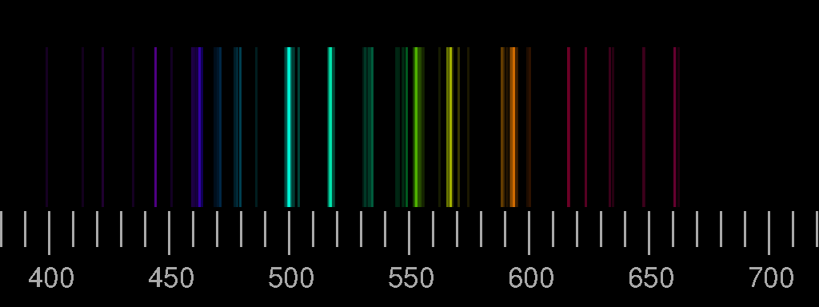

Atomic Spectra

Slide 9
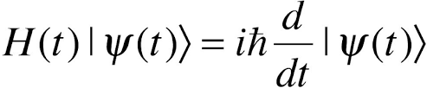
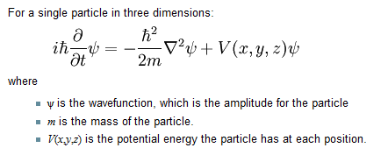
“Wave Function”: Schrodinger Equation

Slide 10
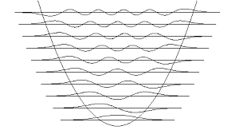
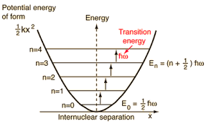
Quantization of Energy of an oscillator

Slide 11
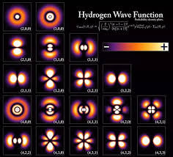
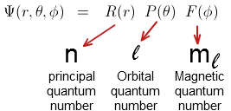
Angular distribution in an atom

Slide 12
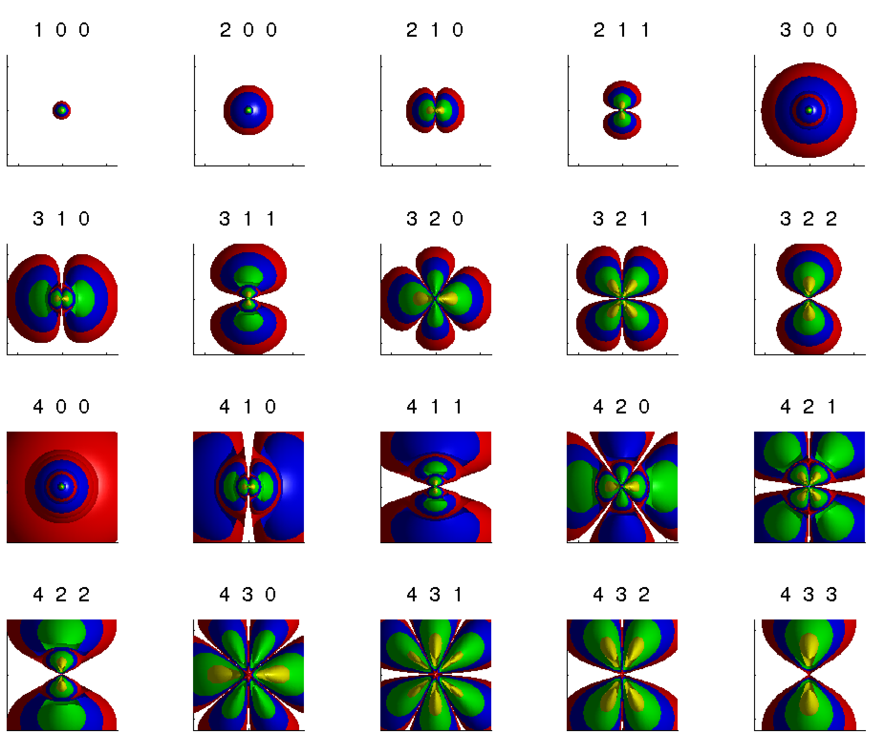
Atomic Energy Levels

Slide 13
Quantum States
These are determined by the Energy function of a system (Hamiltonian) as its ‘Eigen States’
H ψ_{n} = E_{n} ψ_{n}
Solutions are for specific energies, and other Physical Observables …..identified by Quantum Numbers.

Slide 14
Interpretation of “Wave Function”
When expressed as a function of position its absolute value squared is a “probability density” for the particle to be found in a volume: d³ x |Ψ(x,t)|² .
As total probability is then unity for finding it every where the integral of such density is 1.
Solutions are “orthogonal” so overlap integrals are zero ( Note: these solutions form a Hilbert Space) .

Slide 15
Transitions
Occur among such states with calculable probabilities (TP) ( overlap integral with an operator causing the transition inserted in)
These TP determine atomic spectra and their intensities
These TP determine Nuclear states and their spectra ( emission of particles ….or EM radiation …known in this case as gamma rays….)

Slide 16
Conservation Laws
Each Observable is described by an Operator
Observables whose operators “Commute” with the Hamiltonian (Energy Operator) represent CONSERVED Quantities….
Conservation of several quantities determine whether a transition can or cannot occur ……
ONLY commuting operators define quantities that can be KNOWN (measured) simultaneously !

Slide 17
Position and Momentum DO NOT COMMUTE
One may not know the position AND the momentum (mv) of a particle at the same time !
This is actually a reflection of the FREE particle “wave Function” …better referred to as the “State Function” which is :
Ψ(x,t) = A exp i(k.x-ωt) …a plane wave ….no fixed position.

Slide 18
Heisenberg Uncertainty Principle
For any state of a particle one can measure
Δ X = “Volatility in x “ ( uncertainty in x)
Δ p = “Volatility in p” (uncertainty in p)
Quantum Mechanics mandates :
Δ p * Δ x ≥ h (Planck’s constant) !
(Heisenberg Uncertainty Principle)

Slide 19
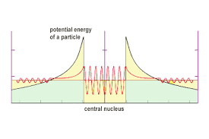
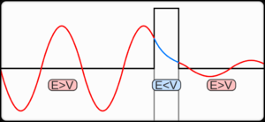
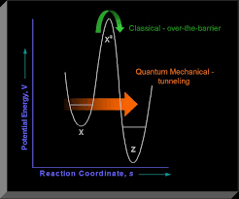
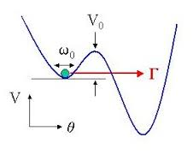
Tunneling

Slide 20
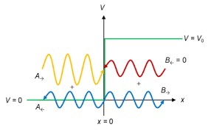
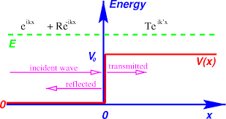
Quantum Reflection

Slide 21
Matrix Formulation ( Heisenberg)
For any operator a matrix may be formed as
O_{nm} = ∫ Ψ*_{n} O Ψ_{m} d³ x
Then H Ψ = E Ψ
Becomes a Matrix equation ! ( Heisenberg Formulation)
Eigen states DIAGONALIZE The Hamiltonian

Slide 22
Interpreting Finite transitions
Sequence of transitions over a series of intermediate states
Intermediate states can be many and varied.
Probability of transition is the average over ALL such “paths”.
Classical Mechanics happens to be the path of maximum probability ( minimum action = Newton’s laws) !
Quantum Mechanics includes ALL paths with varying probabilities !

Slide 23
QM Simulation
The probability for any path is the exponential of the ACTION over that path ( action is KE – Potential energy integrated over the path)
Classical mechanics is ONE path with Minimum action : Therefore Highest probability…but only one path.
Other paths with less probability still contribute to the QM probability of a transition.

Slide 24
SPIN
Particles carry “Internal Angular Momentum” called spin !
Spin is quantized to values of
s =0, ½, 1, 3/2, 2, …..,n/2, n+1, ……
Integer spin : BOSONS
Half integer Spin : Fermions
States of several BOSONS always symmetric under exchange …..
States of Fermions ANTI-symmetric under exchange

Slide 25
Chemistry and “Us” depend on Fermionic “Pauli principle”
TWO Fermions ( e.g. electrons in an atom) cannot exist in the “same state” as then their combinations cannot be made anti-symmetric!
In an atom this FORCES electrons to go to higher levels of energy thus for different atoms the upper electrons are in different energy levels: Chemistry which is the ability of electrons to go from one atom to the other having a lower energy becomes possible …..Hence we can exist.

Slide 26
Quantum Entanglement
Two electrons in an anti-symmetric state will remain so unless disturbed ……
Hence measuring the state of one ….tells about the other !! ….no matter how far they are separated !!
Presents a problem for causality and the requirement for the finite speed (of light) for the transmission of information?????

Slide 27
There is much more of course ….
I hope this has been informative in a general sense …..
Thank you …

